Slide 1
Activity Based on Tessellation
Done By
Students of SBOA School & Jr. College
M. Sai Kavin
Vijay Vignesh
S.R. Raahul
Anne
Mrs. Sayeedha
Mrs. Bina Jonathan

Slide 2
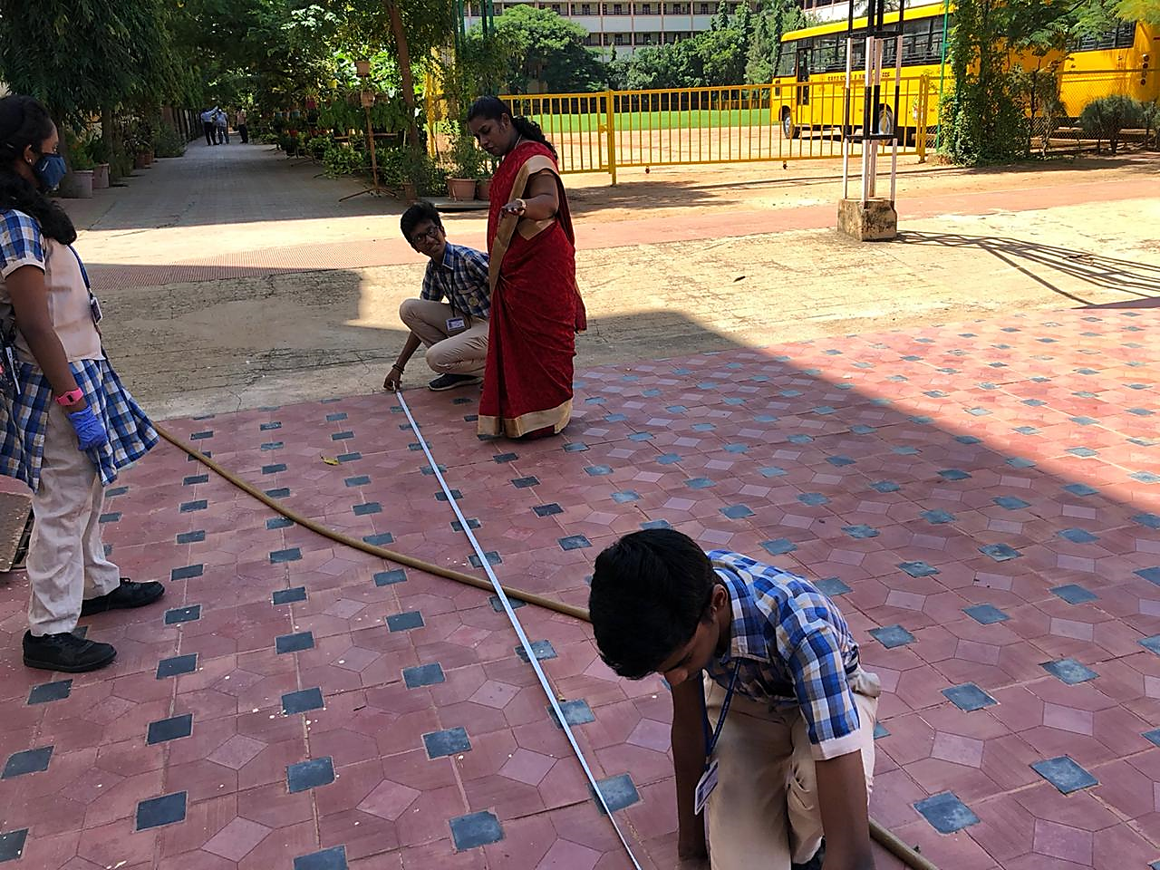
Aim
Tessellation is not just beauty for the eyes. It has many interesting mathematical properties as well. For example, one question that can be asked is, how can we efficiently calculate area using tessellation. we students of SBOA School & Jr. College are presenting an activity to answer this question.

Slide 3
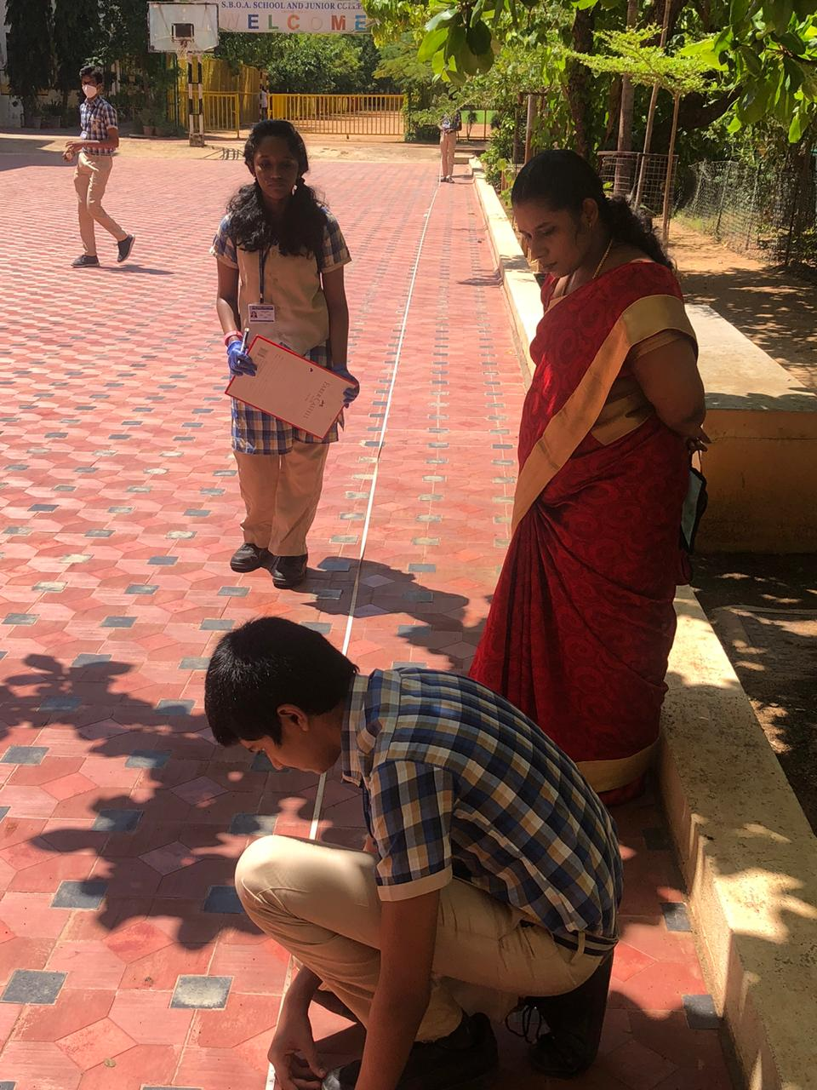
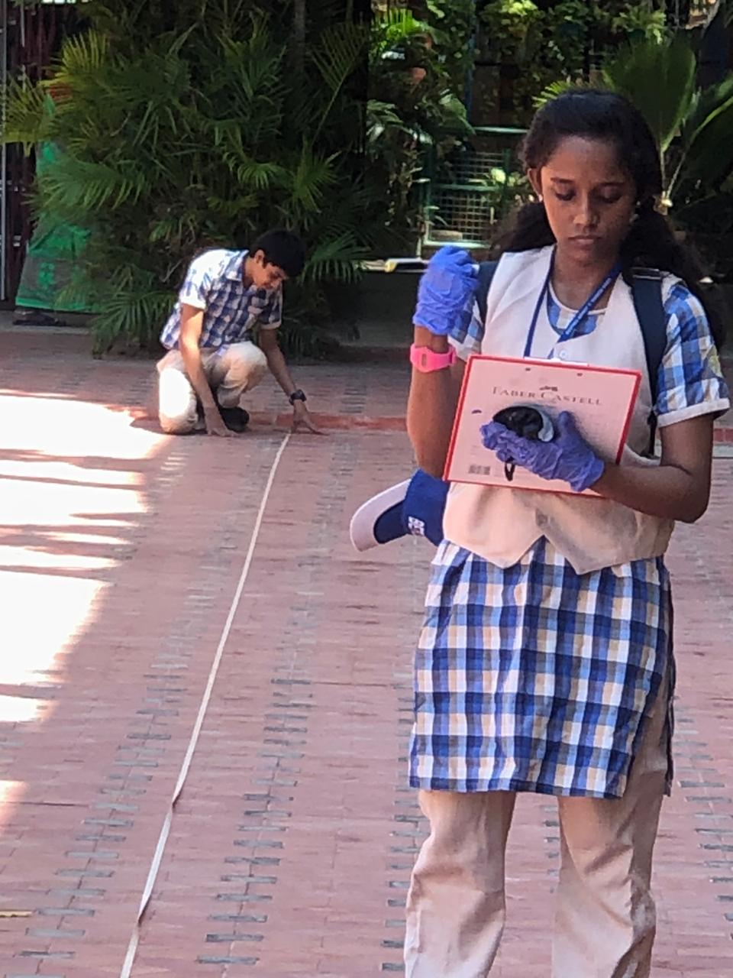
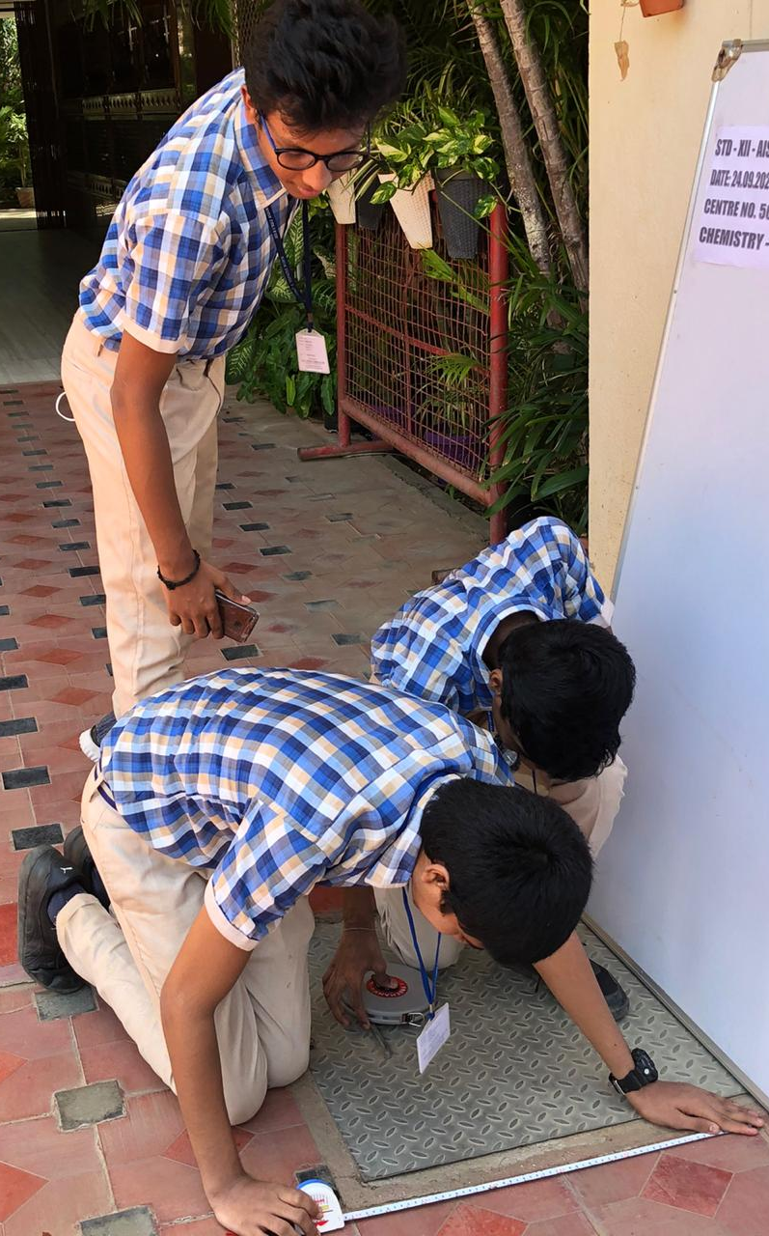
Work in Progress

Slide 4
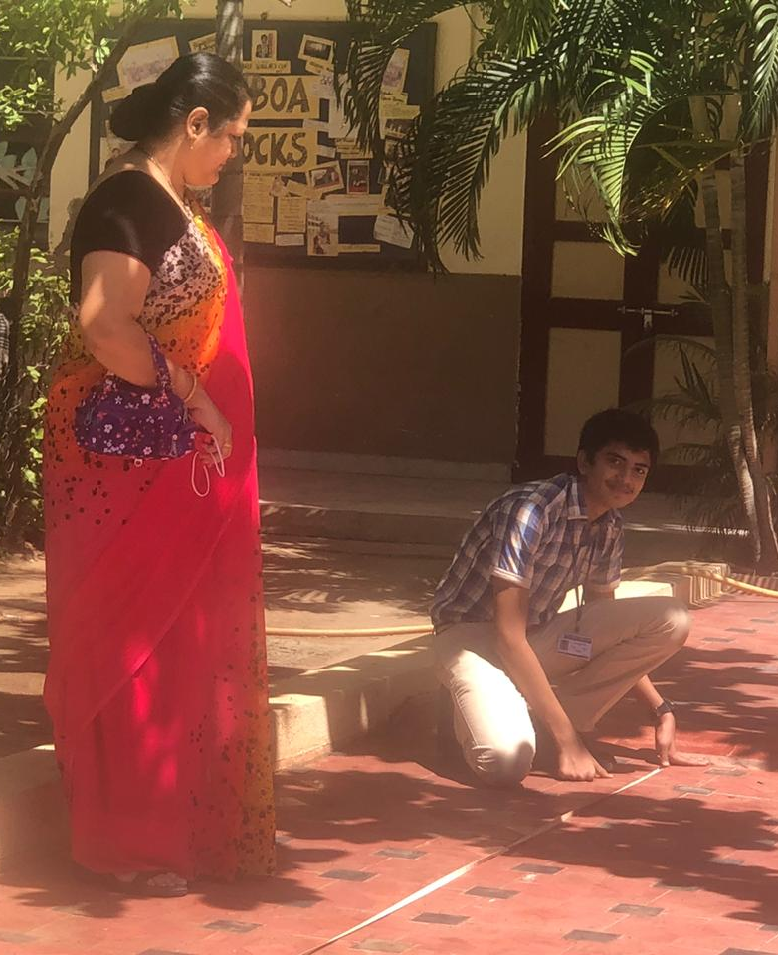
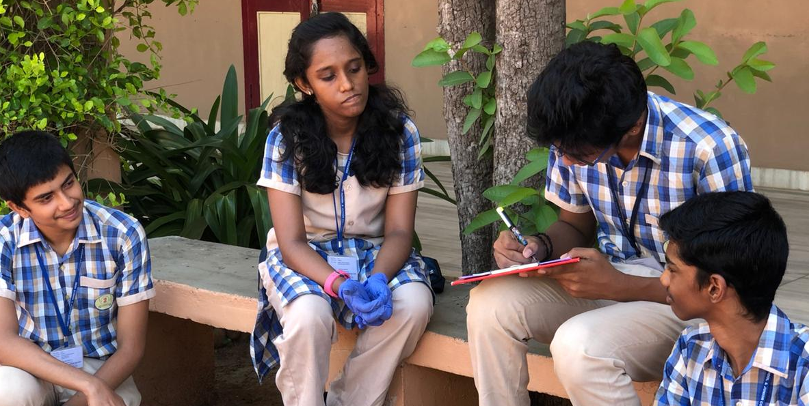
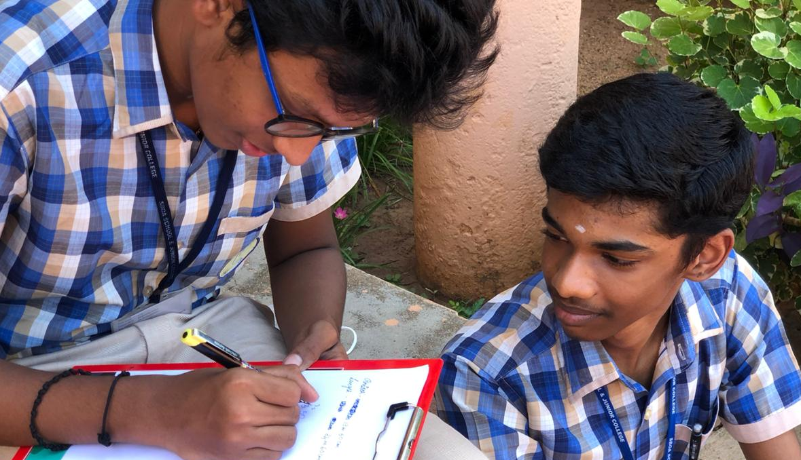
Work in Progress
Calculating the area and finding out the no. of tiles used in our school’s assembly ground. This activity uses the tiling type of tessellation

Slide 5
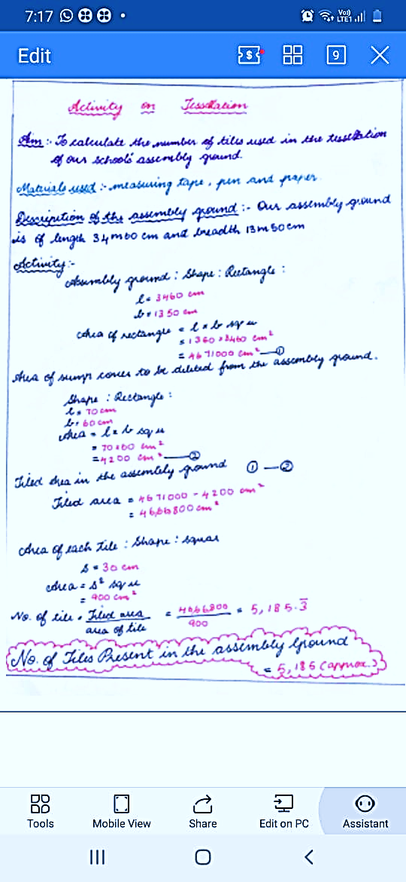
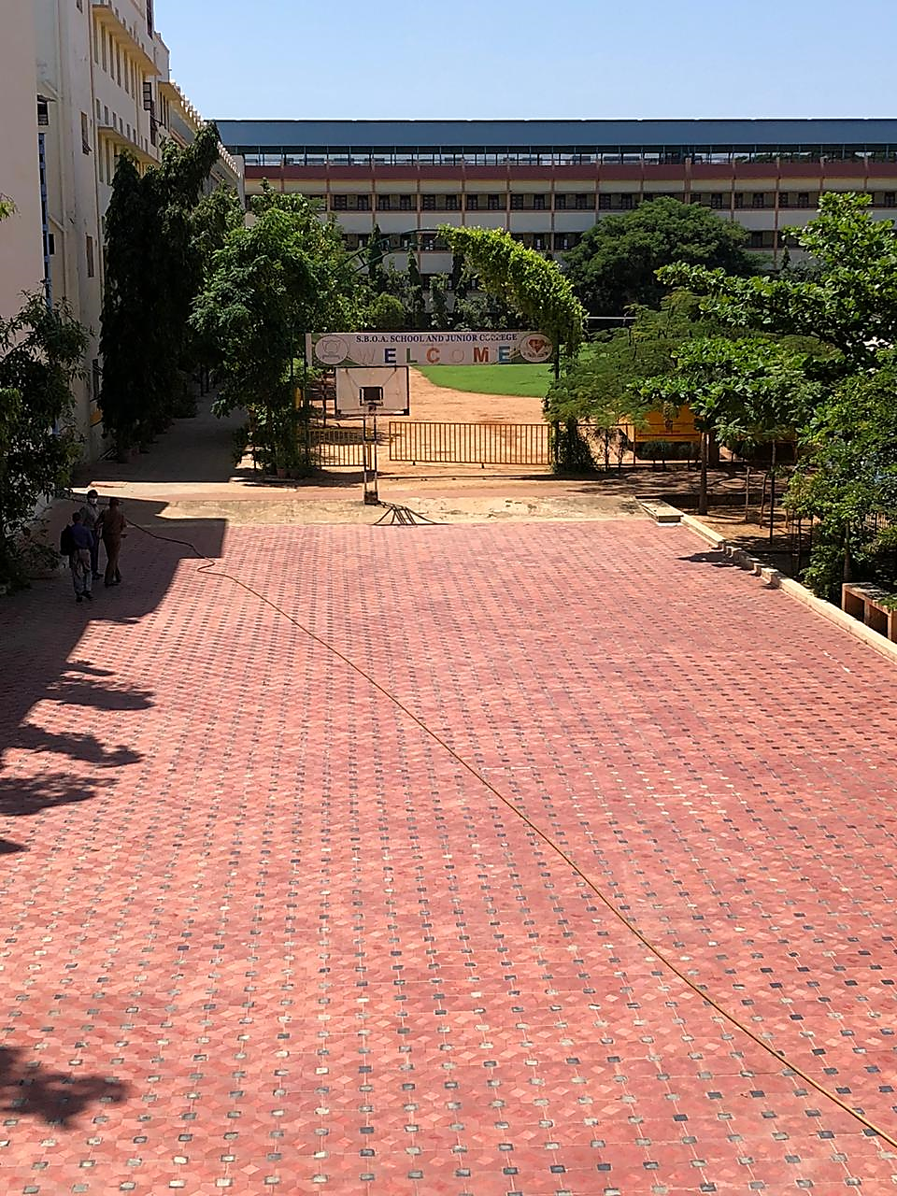
Result

Slide 6
Tessellation On International Scale
“
Do unto others as you would have them do unto you
“

Slide 7
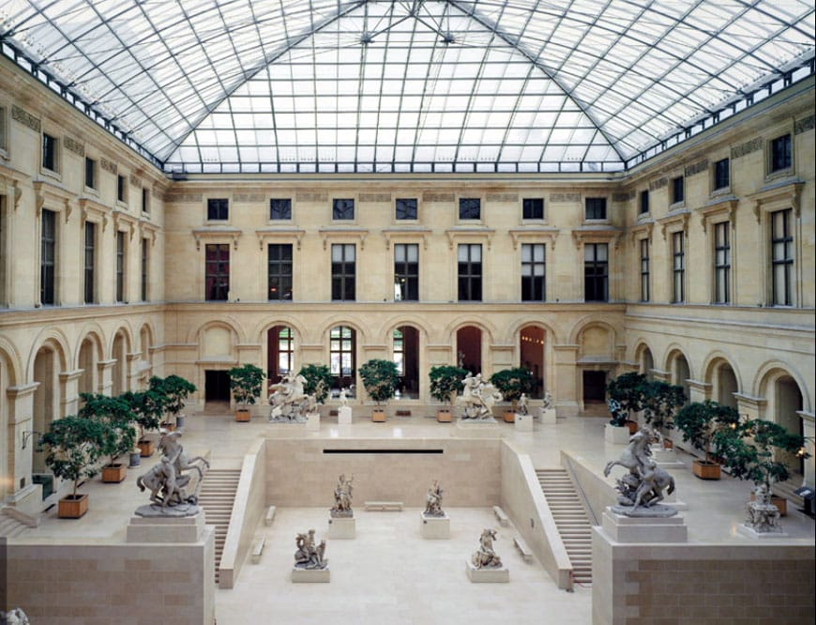
Le Louvre

Slide 8
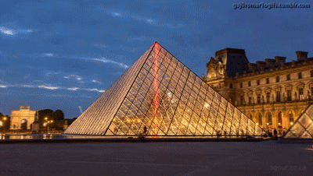
Le Louvre

Slide 9
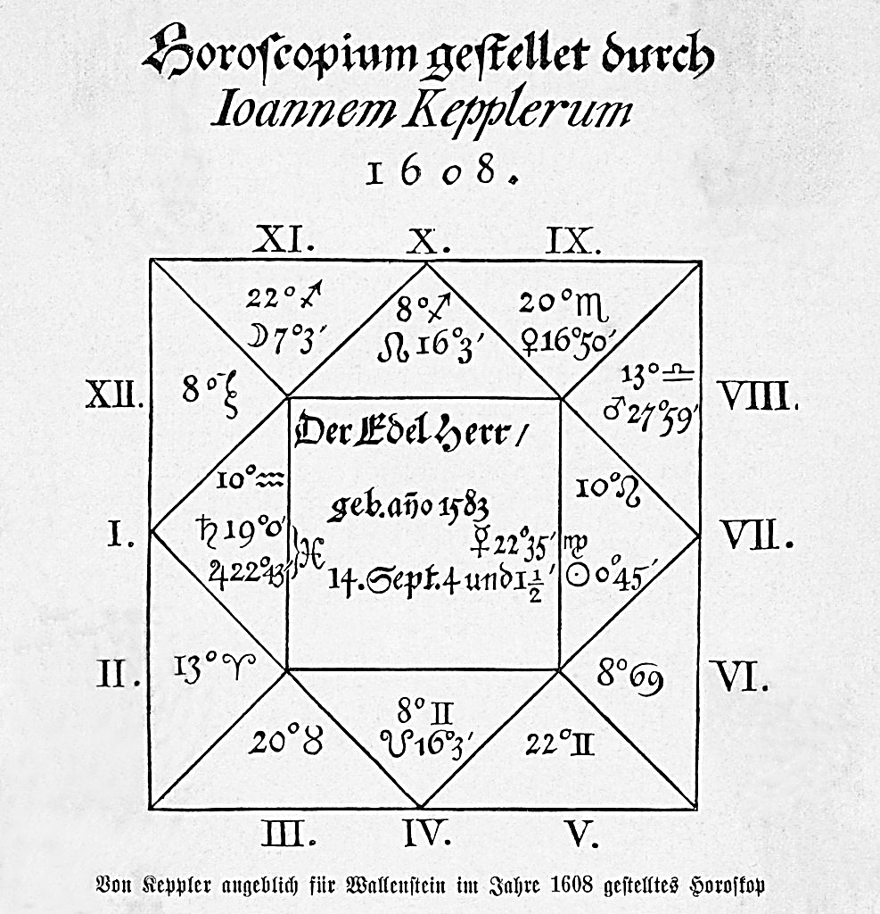
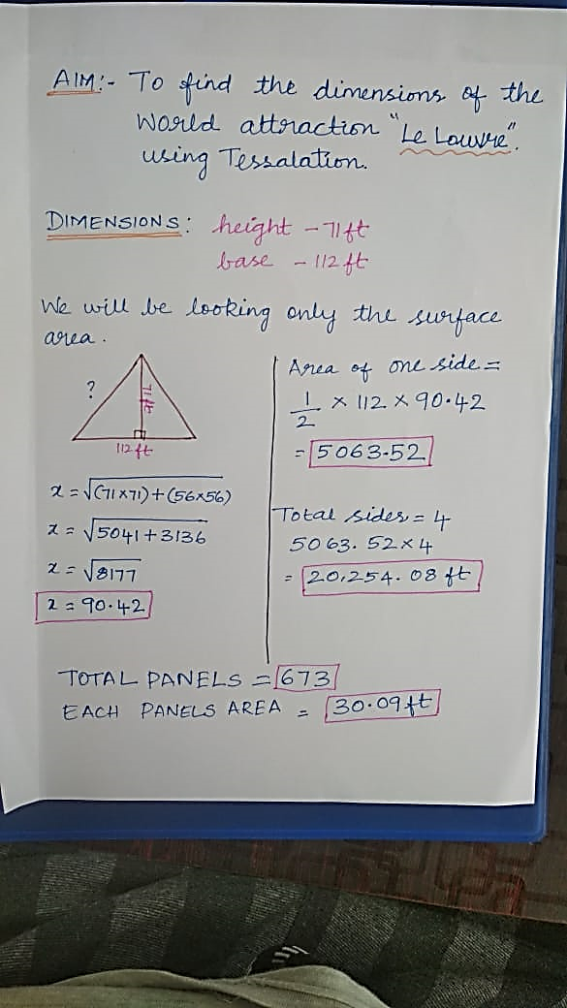
Le Louvre

Slide 10
